Slide 1
Administrative Inquiries
Florida Industrial Security Working Group
December 2012
Charles Duchesne, DSS
Corrie Velez, Lockheed Martin
Jennifer Rossignol, Lockheed Martin

Slide 2
Objectives
Define a compromise
Preparation and prevention
Review steps for conducting an administrative inquiry
*******
Define a classified data spill
Review steps for data spill clean-up
Review steps for conducting an Administrative Inquiry

Slide 3
Required reports
NISPOM 1-302, 1-303
Reports to FBI, etc. (espionage, etc.)
Reports to CSA (DSS)
  Change in status affecting the FCL
  Adverse information
  Suspicious contacts
  Change in cleared employee status
  Inability to safeguard
  Etc.
  …. and …
Reports of loss, compromise, or suspected compromise….
May require an Administrative Inquiry (AI)

Slide 4
What is a compromise?
The disclosure of classified information to an unauthorized person

Slide 5

Types of incidents that may lead to a compromise
Safe left open
Classified material improperly transmitted/received
Data spill
Closed Area not properly secured
Disclosure of classified to an unauthorized recipient
Etc.
SECRET

Slide 6
Attitudes can be a factor
People not following
People not following the rules
Too busy to follow the rules
Confusion
Indifference
It can’t happen here
It costs too much
Everyone else does it

the
rules
Confusion

 Too
busy to follow
the
rules
   
Indifference
It can’t happen here
It costs too much
Everyone else does
it

Slide 7
Prevention and preparation
Prevention – EDUCATION
Preparation – Build a policy, process and team
People not following

the
rules
Confusion

 Too
busy to follow
the
rules
   
Prevention is key!
it

Slide 8
Prevention via education
Employees are the first line of defense when handling classified information
Annual briefings (cleared and uncleared)
  Remember your unclassified IT support staff, too …
Recurring briefings
Sharing news stories, etc.
Reminders – on computers, near safes, at exits
Security classification guide review
Self Inspections
Senior management buy-in
People not following

the
rules
Confusion

 Too
busy to follow
the
rules
   
Indifference
It can’t happen here
It costs too much
Everyone else does
Effective strategy is a combination of training, processes and modifying current behaviors
it

Slide 9
Why do we want to prevent incidents?
We are contractually obligated to protect the
classified information in our control
People not following
Security incidents:
Increase the cost of doing business
    Cost money to investigate
    Cost money to clean up
Can affect an individual’s clearance or program access
Can create friction with customers
Can weaken national security and threaten the warfighter
Can lead to lower than expected inspection ratings

the
rules
Confusion

 Too
busy to follow
the
rules
   
Indifference
It can’t happen here
It costs too much
Everyone else does
it

Slide 10
What are the benefits of prevention?
By ensuring secure and safe information, we enhance customers’ trust and grow our business with new and existing customers
By helping meet our contractual obligations, we help ensure our company’s continued ability to win new business
By reducing incidents we can have a positive effect on the “bottom line” by avoiding wasted time with clean up and remediation efforts
By reducing incidents we help ensure we have done our best to support and protect the warfighter
By reducing security incidents, we help ensure national security

Slide 11
Promulgate a policy
Send to all employees, cleared and uncleared
SECURITY POLICY STATEMENT
It is ABC Company’s policy to safeguard all classified information in accordance with the DoD 5220.22-M, National Industrial Security Program Operating Manual (NISPOM), dated February 2006. All employees shall comply with the company’s Security policies.
At the General Manager for the facility with the responsibility for the facility’s overall operation, I have appointed John Smith as the Facility Security Officer (FSO) and Sharon Martin as the Information System Security Manager (ISSM).
Any employee who fails to adhere to the company Security policies is subject to disciplinary action.
_________________________
Suzy Kuzy
General Manager
People not following

the
rules
Confusion

   
it

Slide 12
Policy for Disciplinary Action
In accordance with the requirements of the National Industrial Security Program Operating Manual (NISPOM), Section 1-304, the following policy is applied at this company.
DISCIPLINARY PLAN: In the event a Security violation or infraction occurs, discipline may be administered. Personnel who commit honest mistakes without negligence or intent can expect minimum impact from this disciplinary plan. Personnel who voluntarily report Security violations or infractions can expect the complete cooperation of Security; however, repetitious mistakes or blatant negligence may result in disciplinary action.
The disciplinary plan recognizes two categories of infringement:
INFRACTION: Any failure to comply with Security regulations or procedures which does not lead to the loss or compromise of classified material.
VIOLATION: Any failure to comply with Security regulations or procedures that results in, or potentially could result in, the loss or compromise of classified information.
PENALTIES: Security violations and infractions with respect to the handling of classified information will be looked at on a case by case basis. The General Manager and the Facility Security officer (FSO), in consultation with the HR Manager, will determine what, if any, disciplinary action will be taken. Violations reported will require documented evidence and will remain on file for a period of not less than 12 calendar months. A graduated measure of response at the very minimum will be employed as follows:
1st Offense: Verbal warning to employee
2nd Offense: Written warning to employee’s file
3rd Offense: General Manager, Facility Security Officer, and HR Manager will determine suitable progressive penalty up to and including termination

Slide 13
Conducting an Administrative Inquiry (AI)
Reference Guide
DSS CDSE Administrative Inquiry (AI)
Process Job Aid
www.dss.mil
http://www.dss.mil/documents/cdse/ai-job-aid-for-industry.pdf
Consult your DSS representative!

Slide 14
Why conduct an AI?
To determine:
If classified information was at risk of compromise and/or was compromised
Who was responsible
Whether appropriate corrective action has been implemented to prevent a recurrence
People not following

the
rules
Confusion

 Too
busy to follow
the
rules
   
Indifference
It can’t happen here
It costs too much
Everyone else does
it

Slide 15
Is there a loss, compromise, or suspected compromise?
People not following
Loss: material can’t be located within a reasonable period of time
Compromise: disclosure to unauthorized person(s)
Suspected compromise: when disclosure can’t be reasonably precluded

the
rules
Confusion

 Too
busy to follow
the
rules
   
Indifference
It can’t happen here
It costs too much
Everyone else does
Typically, data spills are categorized as “compromises” since data is deemed lost
it

Slide 16

Conduct a preliminary inquiry
Conduct immediately
Determine Who, What, When, Where, Why and How
Did a loss, compromise
or suspected compromise occur?
What happened?
NISPOM Para 1-303a
Notes:
The NISPOM requires you immediately conduct a preliminary inquiry into the circumstances around a loss, compromise or suspected compromise.
You’ll may want to follow the reporter’s W5H by interviewing people and determining who, what, where, when, why and how and the extent of the contamination.
You should then make a preliminary finding: Did a loss, compromise or suspected compromise occur?

Slide 17

Conducting a Preliminary Inquiry
If the preliminary inquiry indicates no loss, compromise or suspected compromise of classified, the FSO shall finalize the report and maintain a copy for review by DSS during the next audit
Pssst! You might want to notify DSS before the audit…
People not following

the
rules
Confusion

 Too
busy to follow
the
rules
   
it

Slide 18
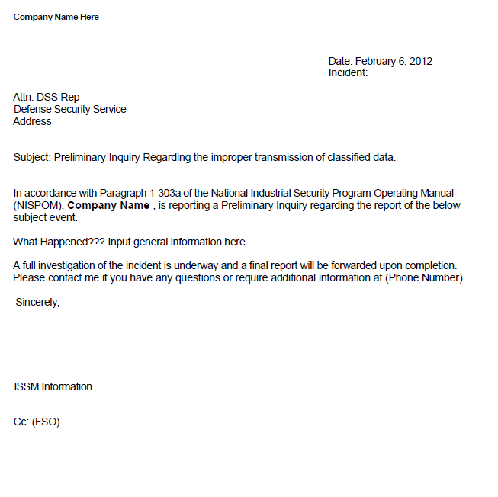
Sample preliminary report to DSS
Timeline for
Initial Report
Top Secret:
within 24 hours
Secret/Confidential:
within 72 hours
Quick, easy, to the point, just the basics
Phone, e-mail, letter?
Note: If on a Government installation, furnish to DSS through the commander

Slide 19

Investigate
Determine what happened
Is the data involved classified? (SME)
Interview all people known to be involved
Get written statements, when possible
Review documentation
Safe logs Alarm logs
Receipts Shipping/Receiving records
Visitor records Video footage
Access control records Guard logs
System logs

Slide 20


Your AI Team
FSO
Security Representative
Site lead
HR
Others
    IT
    Subject matter SMEs
    Classification SMEs
    Export Control

Slide 21

Follow available guidance
NISPOM report requirements (Paragraph 1-303)
DSS Guidance for Conducting an AI
Security Classification Guide(s)
Your own process/checklist
People not following

the
rules
Confusion

 Too
busy to follow
rules
   
it
NISPOM Para 1-303a

Slide 22
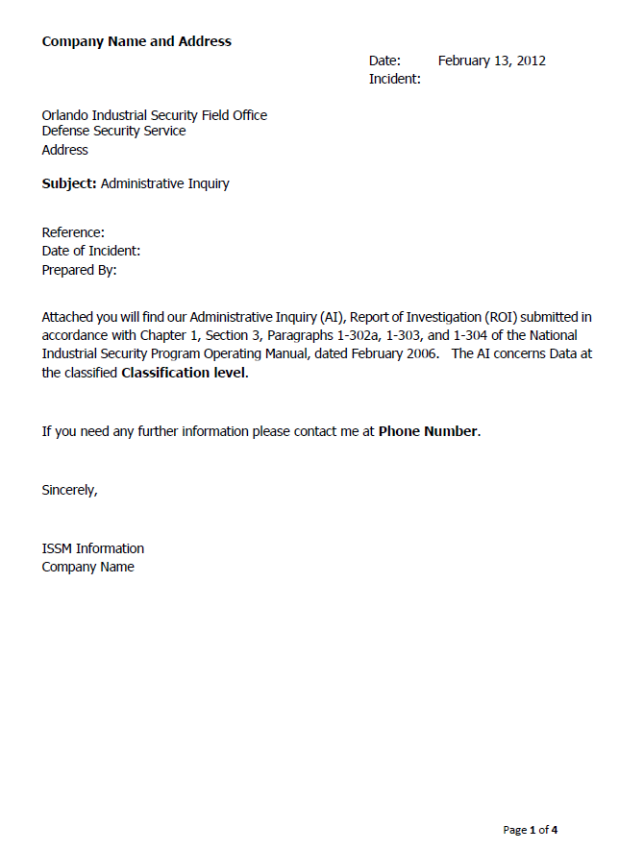
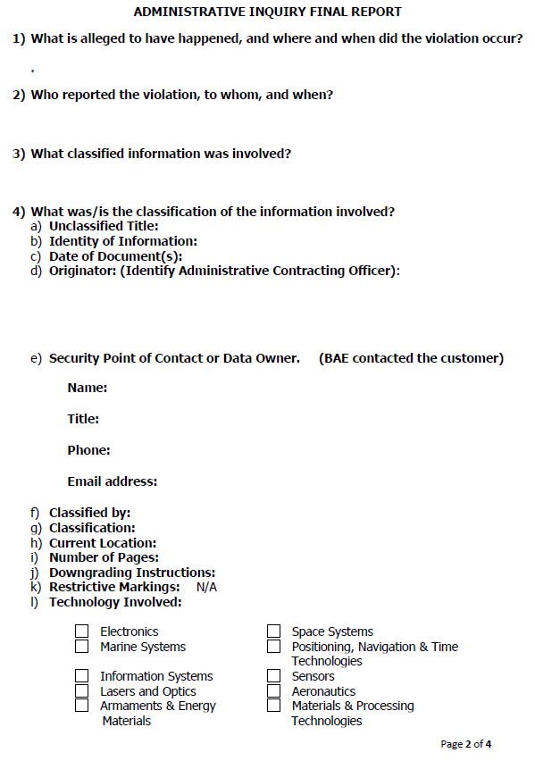
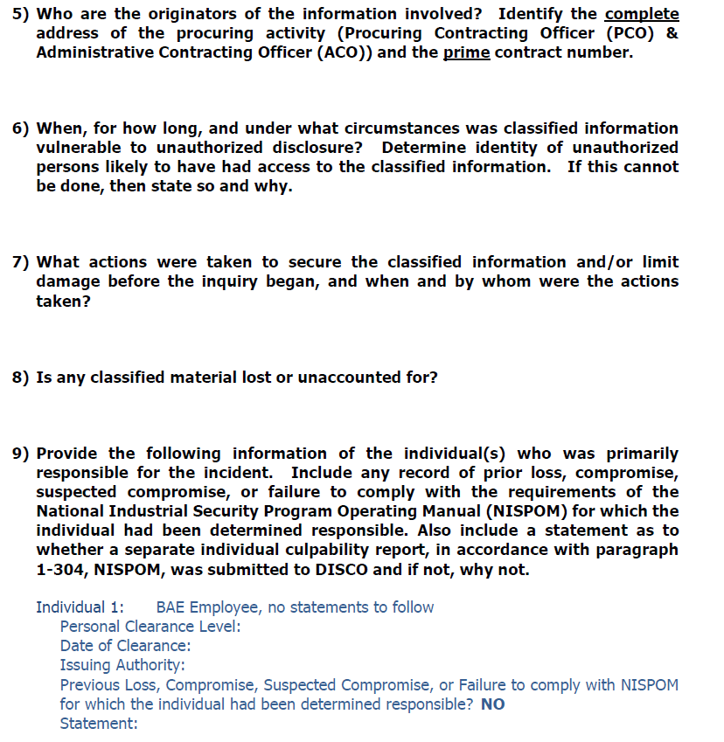
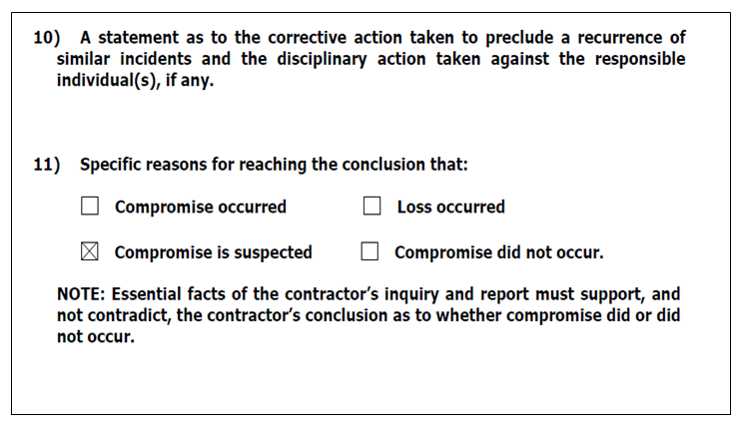
Sample Administrative Inquiry
Step by step process to be reviewed in the workshop

Slide 23
And don’t forget to ….
Protect classified information immediately upon notification and during the investigation
Change combination/s passwords, as necessary
IS: Sanitize/clear the system components. Secure infected systems
BEWARE: Discussion of the incident may be classified!
Retrain/correct/re-assess to ensure process is fixed!
People not following

the
rules
Confusion

busy to follow
When classified information is transmitted or disseminated as unclassified, notification of the actual classified to recipients who are cleared for access to the material is, at a minimum, CONFIDENTIAL. If recipients are not cleared, work with DSS…. Use STE …
 Too
the
rules
   
Indifference
It can’t happen here
It costs too much
Everyone else does

Slide 24
And don’t forget to ….
People not following

the
rules
Consult your DSS representative with any questions!
Confusion

 Too
busy to follow
the
rules
   
Indifference
It can’t happen here
It costs too much
Everyone else does
it

Slide 25
Reporting of adverse
Was conduct knowing, willful or negligent? If so, an adverse information (individual culpability) report might be appropriate.
If the employee is employed on a Federal installation, notify the commander.
NISPOM 1-302a.
People not following

the
rules
Confusion

 Too
busy to follow
the
rules
   
Indifference
It can’t happen here
It costs too much
Everyone else does
More on adverse information to follow ….
it

Slide 26

Report suspenses
Final – when investigation is
complete - 15 days
  Recommend keeping DSS informed of status if need additional time
People not following

the
rules
Confusion

 Too
busy to follow
the
rules
   
it

Slide 27

And finally….
Write and submit the final report (Paragraph 1-303c, NISPOM)
Keep a copy on file (beware of the classification level of the report)

Slide 28
Administrative Inquiries Continued ….
How to Deal with a Data Spill
Charles Duchesne, DSS
Corrie Velez, Lockheed Martin

Slide 29
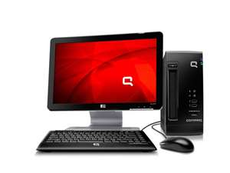
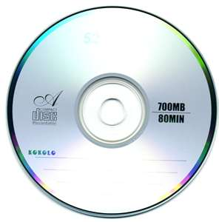
Classified Data Spill
AKA- Contamination or Classified Message Incident
  Occurs when Classified Data is introduced to an Unclassified System or to a system accredited as a lower level classification than the data
SECRET
Unclassified
Ref: ISFO Process Man Rev 3 5.2.3.1

Slide 30
Classified Data Spill
AKA- Contamination or Classified Message Incident
  Occurs when Classified Data is introduced to an Unclassified System or to a system accredited as a lower level classification than the data
SECRET
Unclassified
Ref: ISFO Process Man Rev 3 5.2.3.1

Slide 31
Classified Spill Definition
Classified Spills (also known as contaminations or classified message incidents) occur when classified data is introduced to an unclassified computer system or to a system accredited at a lower classification than the data. Any classified spill will involve an Administrative Inquiry for the facility concerned.
SECRET
(reference ISFO rev 3 section 5.2.3.1)

Slide 32
Data Spill / Incident Response Plan
  Provides a roadmap
  Defines structure, response and capability
  Meets unique organizational requirements
  Defines incidents, resources and support
  Supporting document that can be pre-approved by Data Owners/Customers.
    Reference ISFO Process Manual, Rev 3 2011.1, 5.2.3.1.1

Slide 33

Contamination occurs when…
People not following the rules
Confusion – didn’t understand
Data not reviewed by SME IAW SCG
Received data electronically (email or optical media) from outside source.
Notes:
Once a leak occurs and there is a compromise or potential compromise, this is sometimes the responses from users.
People may not follow the rules for an assortment of reasons. They may be very busy. There may be confusion on the rules or the classification guidance and they didn’t take time to clarify it. They may be indifferent, don’t think it can’t happen in their company or everyone else is doing it. We know this is an economically challenging environment, but sometimes they or the company simply states it costs too much.

Slide 34
Responsibilities
All Personnel
  Immediately open lines of communication
  Participate and support response efforts
  Assess risk / follow data owner (customer) guidelines and/or approved procedures
  Assign cleared people to assist cleanup
Ref: ISFO Process Man Rev 3 5.2.3.1

Slide 35
Responsibilities…cont
FSO
  Acts as incident lead, notifies Government agencies, data and cleaning procedure, Id Sender/Receiver(s) then coordinates the cleanup effort
Ref: ISFO Process Man Rev 3 5.2.3.1

Slide 36
Responsibilities…cont
ISSM / ISSO
  Assess extent of spill and plans cleanup actions
  Contact GCA to receive their spill clean up procedure(s) or receive approval if forwarding the DSS/Contractors’ procedure(s).
  Conducts cleanup actions
  Reports findings
  Protect/Isolate systems from further contamination, etc
Ref: ISFO Process Man Rev 3 5.2.3.1

Slide 37
Follow available guidance
NISPOM Admin Inquiry (AI) Report Requirements (Paragraph 1-303)
  http://www.dss.mil/documents/odaa/nispom2006-5220.pdf
DSS Guidance for Conducting an AI
  http://www.dss.mil/documents/cdse/ai-job-aid-for-industry.pdf
Clearing and Sanitization Matrix
  ISFO Process Manual Rev. 3 2011.1 (to order the manual, go to: http://www.dss.mil/isp/odaa/request.html)
Notes:
This is where you should bring out the guidance we discussed earlier. It will provide valuable assistance in writing the report and with cleanup. Be especially careful to follow the requirements in the Clearing and Sanitization Matrix.

Slide 38

Where to begin?
Assemble team
Physically isolate, protect all contaminated equipment
Remove access from
unauthorized personnel
Notes:
This is where you might consider assembling the ad hoc team if you established one.
You should prevent further spread and keep unauthorized persons from accessing the information.
You may want to consider disconnecting the network, restricting access to affected files and securing all equipment and media

Slide 39


What should be done? (cont.)
Call your Defense Security Service (DSS) IS Rep and/or ISSP*
Contact your customer, the data owner
“Would you
take care of
this for me!”
DO NOT delete the suspect data yet!
* Information Systems Security Professional
Notes:
After securing the information, notify DSS and the government customer for instructions regarding how to proceed with cleanup. Depending on the situation, the customer and DSS may suggest actions ranging from “do nothing” to “destroy all media.”
If you delete data now, however, you may complicate a cleanup that could be more simple. This might be an instance where a selective file overwrite might be applicable and could save you from overwriting an entire server. Each situation should be discussed with DSS and government customer personnel.

Slide 40

What to expect from DSS
Help you limit further systems from being contaminated.
Work with you on sanitizing all infected systems.
Notes:
2
Once the IS Rep and ISSP are notified, they will do as much as possible to work with you in the cleanup and to limit further systems from being contaminated.
If you don’t have a procedure for sanitizing the system because it’s unclassified, they may try to help you find one.

Slide 41
Some important facts to consider…
What platforms and O/Ss are involved?
Are there any remote dial-ins
Are there any other network connections?
At what locations was the file or e-mail received (e-mail servers) or placed?
Was the data encrypted?
Was the file deleted?
Is there RAID technology involved?
  ISFO Process Manual Rev. 3 2011.1 contains step-by-step descriptions starting on pg 100…to order the manual, go to: http://www.dss.mil/isp/odaa/request.html
Notes:
5
-- These are some of the important questions that could be applicable. Thinking of a contamination as though it were a glass of spilled liquid, might help you to think through where all the information could possibly reside.
-- If a child spills a glass of milk, it goes on the table, under plates, onto the sides of the tables, in someone’s lap and finally onto the floor. Contaminations are much the same way.
-- Determining the operating systems and having SysAdmins there that specialize in the O/S, allows the company to take advantage of features in the software to assist with cleanup.
-- You may want to consider remote dial-ins. Could involve people working from home, laptops (travel), external networks.
-- Determine what servers are involved: Email server, any engineering servers
-- Was the data encrypted in any way: PGP or other encryption means there is some protection around the information
-- If the file deleted, the chances are that the contractor will be asked to overwrite the hard drive instead of just the file.

Slide 42
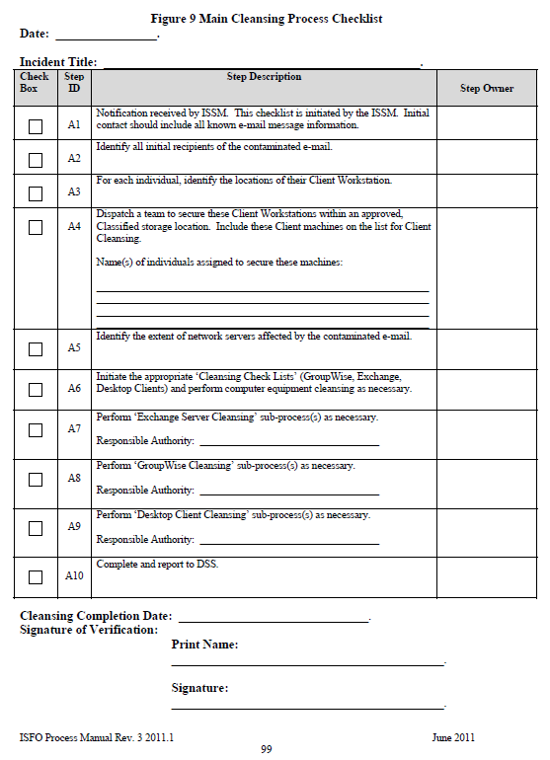
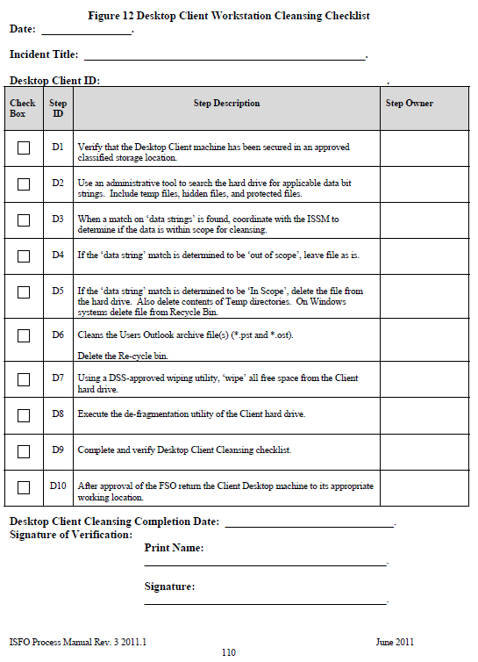
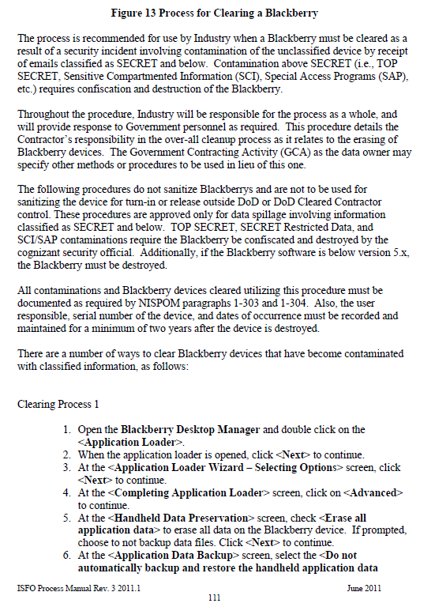
ISFO Cleansing Checklists
Inside of ISFO
(General, Desktop, Bl ackBerry devices and Email Servers)
Some Data Owners / customers may provide specific guidance / checklists to be used
Notes:
2
Once the IS Rep and ISSP are notified, they will do as much as possible to work with you in the cleanup and to limit further systems from being contaminated.
If you don’t have a procedure for sanitizing the system because it’s unclassified, they may try to help you find one.

Slide 43
What about an email server?
What type of email system is involved?
Is System Admin cleared?
Is Tape/Disk Backup Admin cleared?
Ensure areas where deleted files are retained are addressed, e.g., MS Exchange’s deleted item recovery container).
MS Exchange is discussed because of its widespread use. DSS does not endorse the use of any products.
Notes:
5
If email is involved, it will be important to take a close look at the way it operates and if it has areas where deleted email is saved. For instance Microsoft’s Exchange has a deleted item recovery container. Obviously, this would also need to be included in any sanitization operations. There are a couple of Microsoft Knowledge Base articles that could be helpful: Article # Q223161 on zeroing; also Articles # Q260037 and Q232006). I have only given you the example of Microsoft Exchange, as it is so widely used. DSS does not endorse any products.

Slide 44
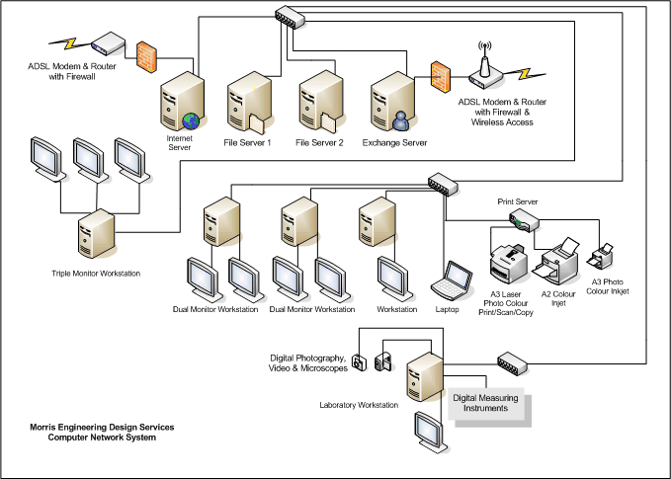
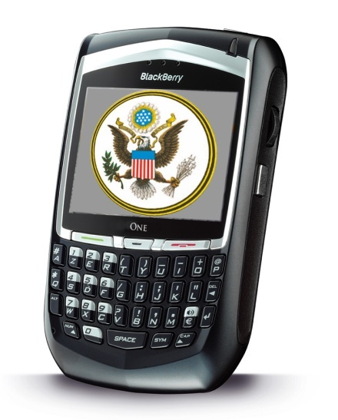
Forget any components?
Notes:
Remember to look at the entire system when conducting an administrative inquiry. Sometimes during an incident such as this, employees with advanced degrees in computer science have forgotten about backup tapes and offsite locations.

Slide 45
Follow through!
Gather and review Audit trails that are applicable
  Paper
  Electronic
Interview all people known to be involved
- Note…Do not use email to communicate the “Who, What, When, Where, Why, How” except for reporting requirements to DSS/Customer or others involved, (i.e. other contractors)
Notes:
Audit trails are important aspects of the AI as they reveal who and how the system has been used. They may provide you with additional details as to who accessed the system during the time of the contamination. Also, some email systems will record further dissemination of email.
It would be a good idea not limit your interviews to only the people on the system as there may have been other people involved indirectly.

Slide 46
Prepare Final Report
Write and submit the final report (Paragraph 1-303c, NISPOM)
Due within 15 days of notification of spill
Notes:
NISPOM Paragraph 1-303c requires you submit a final report to DSS. This should be very complete and cover any additional details not covered in the preliminary report.

Slide 47
Final Actions
Request they provide additional cleanup steps within 30 days
Send details to government customer to include cleanup action
Include hardware and operating system platforms
“Create your data spill / incident plan prior to experiencing a data spill, for if you fail to plan, your plan will fail!”
~ Anonymous ISSM
Notes:
Lastly, DSS will ask you to notify your government customer of the situation, what type of hardware and operating system platforms are in use and what cleanup action the company has taken. Additionally, DSS will ask you to request they provide you with any further cleanup procedures within 30 days.

Slide 48
Overwrite utilities programs
Determine types of devices and operating systems involved.
Locate (acquire) approved overwrite utilities to sanitize the suspect data from systems
  Contact your DSS ISSP or the Data Owner if you require additional information on how to sanitize the affected media.
Administrative Inquiry (AI) Guidelines for Information Systems (IS) https://enrol.dss.mil/courseware/is201docs/AI_Guide_Nonaccredited_IS.pdf

Slide 49
Overwrite utilities:
NIST Common Criteria (Sensitive Data Protection)
Sun’s “Purge” ( Part of the O/S)
SGI “FX” (Part of the O/S)
Unishred Pro 3.3.1 (EAL1)
BCWipe Total WipeOut
Terminus 6
White Canyon Wipe Drive (EAL4)
Note: This is a partial list of products that have enabled contamination cleanup in the past. DSS does not endorse any products.
Notes:
8
Here is just a partial list of products that have been authorized for cleanup in the past. As stated earlier, DSS does not endorse use of any products. You can refer to the Assessed Products List on the DSS Information Assurance website for further information.

Slide 50
Summary
What causes contaminations
Possible cleanup considerations
Reporting requirements
NISPOM Para 8-103b,c
Notes:
I have reviewed with you some things that cause contaminations, some possible cleanup considerations and the NISPOM reporting requirements. Thank you for your attention.

